Slide 1

Presentation on Road Sign Detector and Driver Alert System
Presented By
Shailesh Goswami (22MCI0007)
Sarthak Tripathi (22MCB0030)
Shantanu Das Gupta (22MCB0026)
Guided By
Prof. Dr.Yokesh Babu S
Date -23/01/2023

Slide 2
Contents
Domain
List of Issues
Issues to be focused
Introduction
Literature Survey
Problem Statement
Proposed Solution
Methodology
Experiments and Results
Conclusion and Future Work
References

Slide 3
Domain
Road Safety: This project will focus driver’s safety using Image processing techniques.
Image Pre-Processing
Deep Learning: The deep learning algorithm CNN is used due to its ability to recognize patterns in images.

Slide 4
List of Issues
Bad lighting conditions make it harder to gather colour and contour information of traffic sign.
Occluded Traffic sings with sunlight and dark.
Motion blur and car vibration makes harder to retrieve images from the camera.
Damaged traffic sign.

Slide 5
Issues to be focused
Identify, categorize and warn to the driver for traffic signs.
Safety of the drivers and the fellow travelers
Clearer Diagnosis of road signs

Slide 6
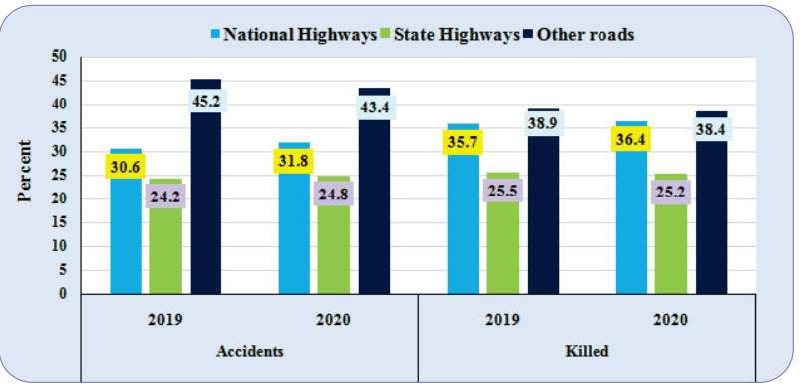
Road Accident Statistics
During the calendar year 2020, there were close to 5lakh road accident in India, which resulted in more than 1.3lakhs death and inflicted injured on 5.2lakh persons. These numbers translate into one road accident every minute and a road accident death every 4 minute. More than half of these victims are in active age group of 25-65 years. Following graph gives percentage of the total number of accident took place and people killed from 2019-2020.

Slide 7
Introduction
Road traffic has been the major issue that most cities are facing these days. People neglect the importance of traffic signs which could prove deadly. Currently, the maps services assist us about some details of navigation, but it fails to provide essential information such as “U-turns, prohibited roads, speed-limits, speed breakers and diversions etc.”, which are generally present on the signboards. These are of utmost importance for road safety but the drivers often miss out on them. There is urgent need for a mechanism which would be able to detect these signs and alert the drivers. So, an expert system based on CNN, will detect & recognize the signboards in real time.

Slide 8
Traffic sign recognition system is a crucial research direction in computer vision and a significant section of Advanced Driver Assistance System (ADAS). It can be grouped into two technologies, traffic-sign detection and traffic-sign recognition. The correctness of detection will directly lead to the final identification results. Traffic signs contain necessary messages about vehicle safety and they show the latest traffic conditions, define road rights, forbid and allow some behaviors and driving routes, cue dangerous messages and so on. They can also help drivers identify the condition of the road, so as to determine the driving routes.
Traffic signs have some constant characteristics that can be used for detection and classification, among them, color and shape are important attributes that can help drivers obtain road information. The image of traffic signs is often affected by some external factors, such as weather conditions. Therefore, traffic-sign recognition is a challenging subject and also a valuable subject in traffic engineering research.

Slide 9
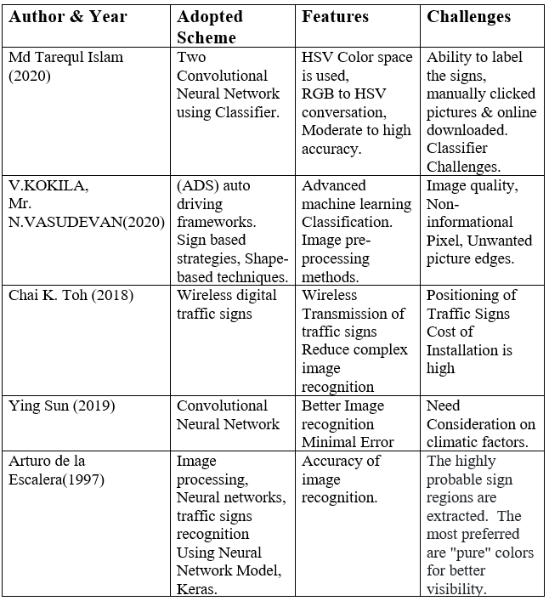
Literature Survey

Slide 10
Problem Statement
The objectives of the system is first to detect and then classify signs. This works well when we have lots of images as well as not clear ones.
For classifying images we are using Convolutional Neural Network Model

Slide 11
Why CNN is better than other Models
CNN are hugely popular is because of their architecture — the best thing is there is no need for feature extraction. The system learns to do feature extraction and the core concept of CNN is, it uses convolution of image and filters to generate invariant features which are passed on to the next layer. The features in next layer are convoluted with different filters to generate more invariant and abstract features and the process continues till one gets final feature / output (let say face of X) which is invariant to occlusions.
another key feature is that deep convolutional networks are flexible and work well on image data. As one researcher points out, convolutional layers exploit the fact that an interesting pattern can occur in any region of the image, and regions are contiguous blocks of pixels. But one of the reasons why researchers are excited about deep learning is the potential for the model to learn useful features from raw data. Now, convolutional neural networks can extract informative features from images, eliminating the need of traditional manual image processing methods.

Slide 12
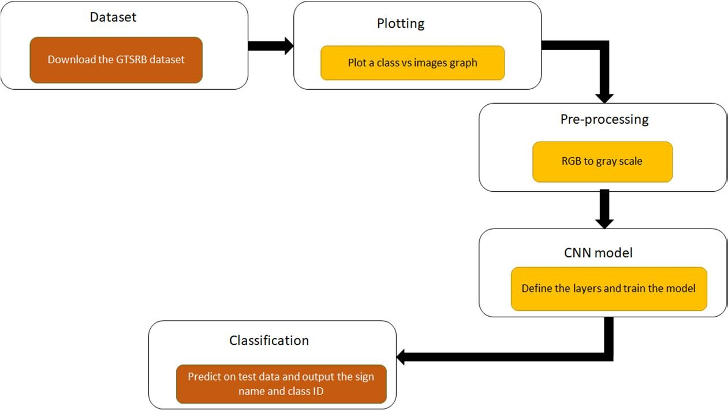
Proposed Solution

Slide 13
Methodology
Explore the Dataset
The presence of a generalised dataset is crucial before moving on to the detection or classification.
The GTSRB (German Traffic Sign Recognition Benchmark) dataset is the most popular of them.
There are numerous images in it.
The variety, backdrop, and colour variation of the traffic signs will aid in the model's performance accuracy.
For this project, we are using the public dataset available at Kaggle:
Traffic sign Dataset
The dataset contains more than 50,000 images of different traffic signs. It is further classified into 43 different classes the dataset is quiet varying, some of the classes have many images while some classes have few images. The size of the dataset is around 300MB. The dataset has a train folder which contains images inside each class and a test folder which we will use for testing our model.

Slide 14
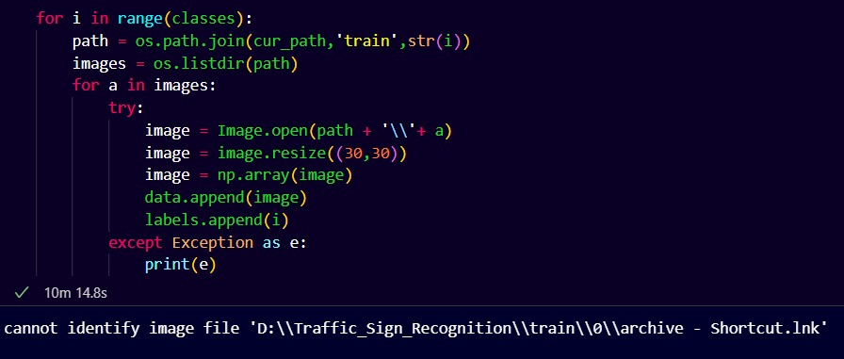
Pre-Processing

Slide 15
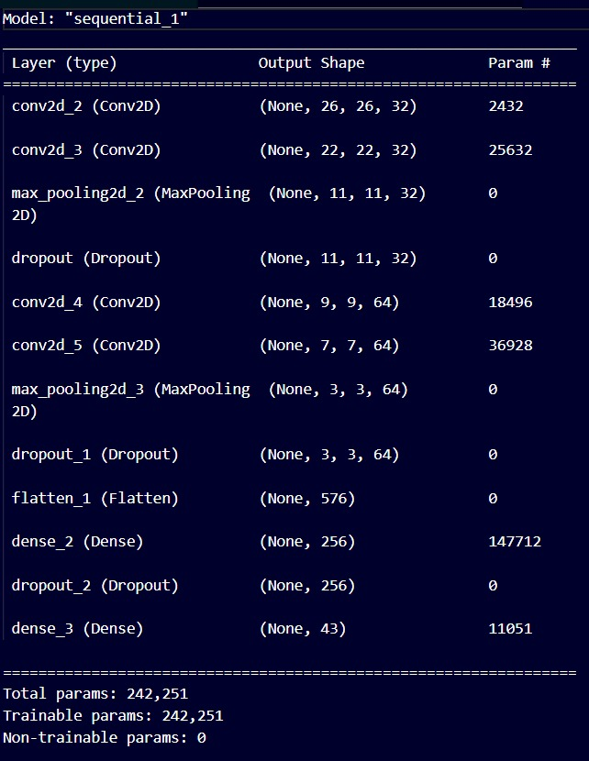
Build the CNN model

Slide 16
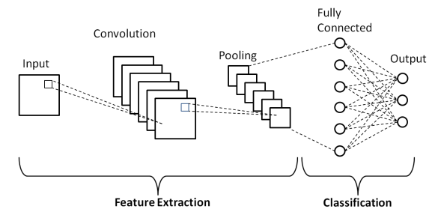
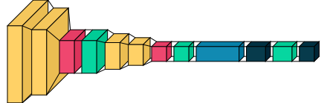
Schematic diagram of a basic convolutional neural network (CNN) architecture.
Visualization CNN model with its layers

Slide 17
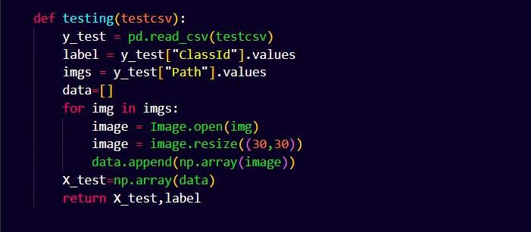
Test the model with test dataset

Slide 18
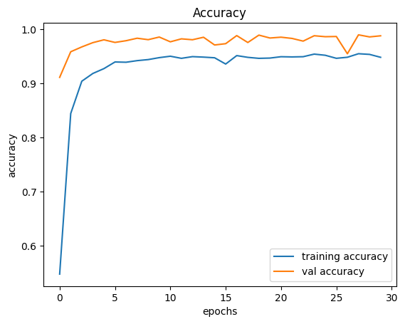
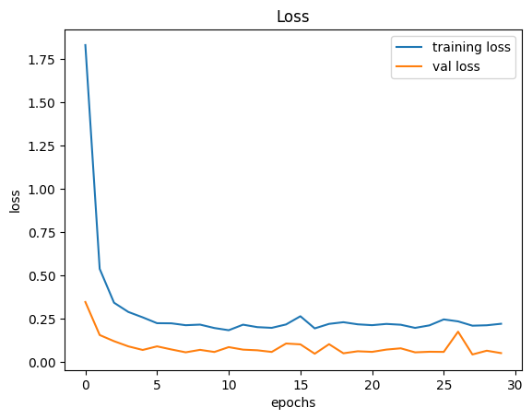
Accuracy and Loss Graph for testing data:
Accuracy
Loss

Slide 19
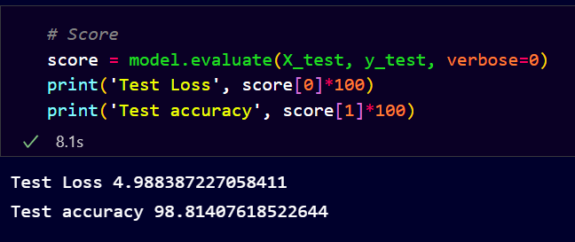
Accuracy Score for testing Data

Slide 20
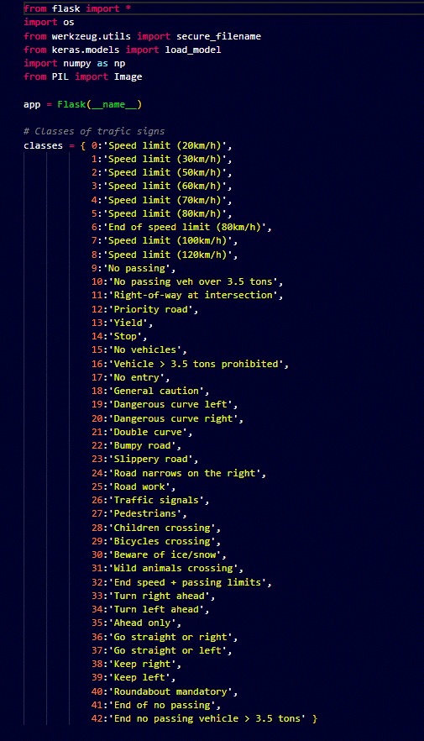
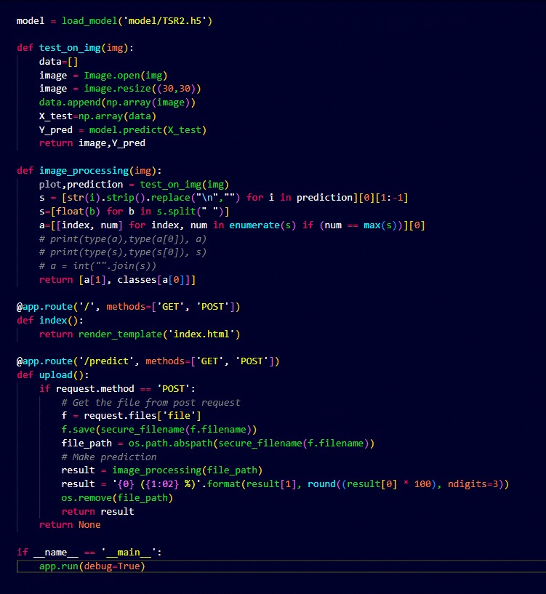
Experiments
Building the front-end for the Model

Slide 21
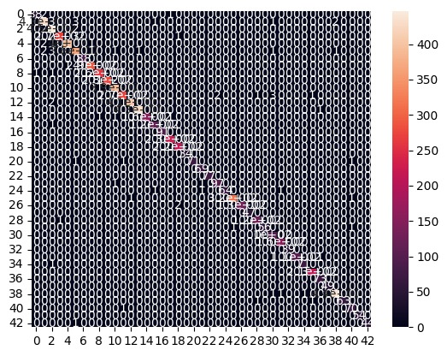
Model Evaluation through Confusion Matrix

Slide 22
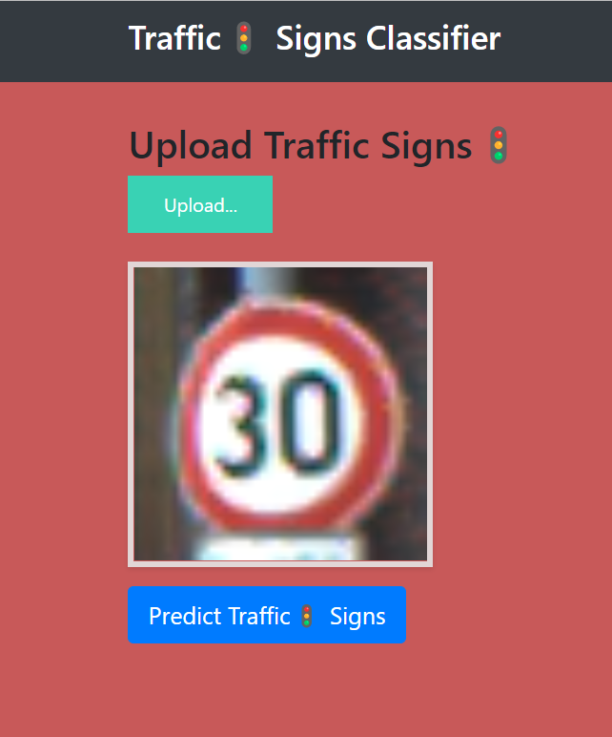
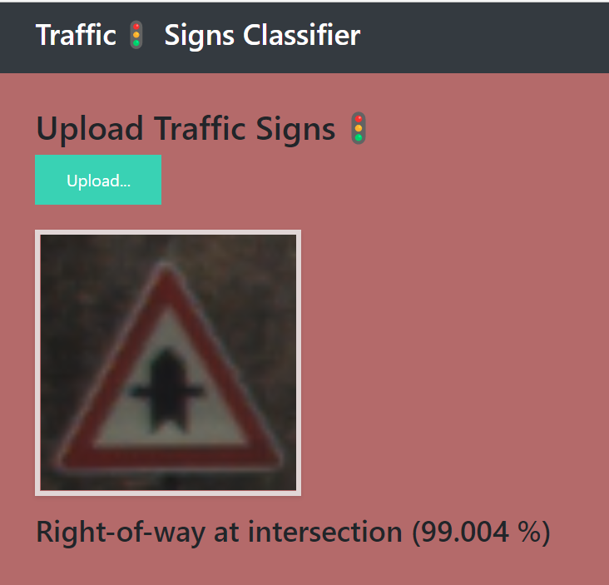
Result
The trained CNN's test results reveal that the model is 98.81% accurate at identifying and detecting traffic signs. The experimental finding demonstrates the CNN model's strong recognition accuracy for detecting and identifying road signs.

Slide 23
Conclusion and Future Work
This project presents a method for recognizing traffic signs using deep learning. This approach is efficient in identifying and recognizing traffic signs by utilizing image pre-processing, road sign detection, and classifying. Results of the testing show that the accuracy of this method is 98.81%.
In future, we will keep extending our datasets to cover all classes of our traffic signs. Meanwhile, more newly developed models for visual object recognition, such as Mask R-CNN, CapsNet, and Siamese neural network would be included. Capsule neural network (CapsNet) has been employed for effectively identifying a class of traffic signs which have spatial relationships. Compared with the well-known deep neural networks, capsule networks tackle the topological relationship between visual objects. In addition, we will adopt professional evaluation metrics to assess the performance of our models from multiple aspects in future.

Slide 24
References
Chen T, Lu S, “Accurate and Efficient Traffic Sign Detection Using Discriminative Adaboost and Support Vector Regression,” IEEE Transactions on Vehicular Technology, 2016, 65(6):4006-4015.
https://towardsdatascience.com/adam-latest-trends-in-deep-learning-optimization-6be9a291375c
J. Crissman and C. E. Thorpe “UNSCARF, a colour vision system for the detection of unstructured roads,” in Proc. IEEE Int. Conf. Robotics and Automation, Sacramento, CA, Apr. 1991, pp. 2496–2501.
https://www.carandbike.com/news/traffic-sign-recognition-function-and-intelligence-2963101
Who, “Global status report on road safety,” Who, Geneva, Switzerland, 2018.
https://towardsdatascience.com/using-convolutional-neural-network-for-image-classification.
https://machinelearningmastery.com/adam-optimization-algorithm-for-deep-learning/
https://www.kaggle.com/datasets/meowmeowmeowmeowmeow/gtsrb-german-traffic-sign.
https://pyimagesearch.com/2019/11/04/traffic-sign-classification-with-keras-and-deep-learning/

